Slide 1
How to raise UAT issue
(User manual)
11.05.2018

Slide 2
Definition
Priority
Supported breakpoints
The site will support the following three main breakpoints provided as part of SCCD and will be fluid up to a maximum screen size which will be dependent on the final design:
320px Mobile
768px Tablet portrait
1024px Tablet landscape
Maximum screen width
UAT Jira tickets review and triage
There will be a specific Jira dashboard https://jira.tryzens.com/secure/Dashboard.jspa?selectPageId=19690# to display the list of UAT issues (ordered by priority) and to allow triage and proper prioritization.
Priority |  | DEFINITION
1 | Critical | Defect renders all or a portion of the system under test inoperable, meaning testing cannot continue.
2 | High | An area of functionality does not work and is preventing test scripts being run or completed. Defects affecting core functionality or data where no workaround is available and require urgent action to rectify. These defects can seriously impact testing, potentially delaying the majority of a test cycle and therefore must be resolved before the software is released to a production environment The defect results in an unacceptable customer experience or is detrimental to Maaji
3 | Medium | Defect identified that prevents the completion of a specific test step only, but has only a minor business, brand or customer experience impact. The defect has a workaround that allows that area of functionality to be used within the business processes.
4 | Low | A defect has been noted that does not cause a test to be rejected or any test step to fail and minimal or no business, brand or customer experience impact. E.g. cosmetic, spelling mistake, misaligned text, email or page components.

Slide 3
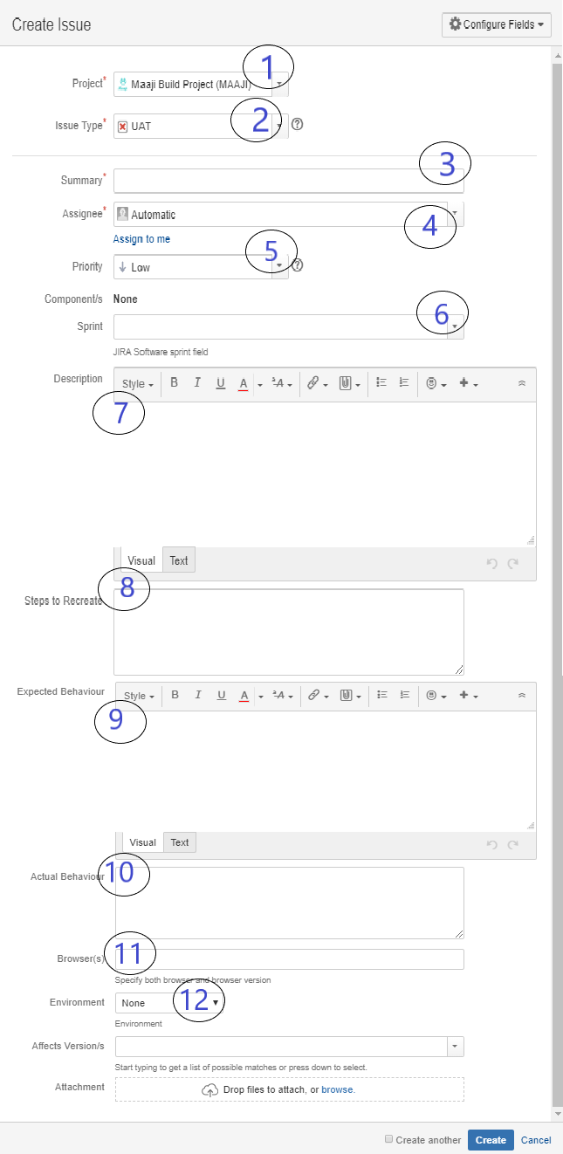
Create new UAT issue:
Make sure you have selected Maaji build project.
Select issue type UAT
Brief description of the issue found
Assign the Jira to Antoniya Dragomirova
Select based on the definitions above.
Leave empty
Specify detailed description of the issue observed.
Add steps for recreating the issue
Add what you expected to see
Add what you actually see
Specify the browser/devise the issue was spotted (if it is browser/device specific)
Add the environment you`re testing on
Add screenshots, files, any other (if applicable)

